Slide 1
Artemis Biomedical, Inc.
Non-invasive Blood Glucometry

Slide 2
This slide deck - introductory
Discussion of the market opportunity
Founding Team and other key players
Introduction to our solution
High-level discussion of our plan; review of progress
Capitalization

Slide 3
Market Opportunity
In 2025, 50% of Americans will be diabetic or pre-diabetic
Other countries are tracking closely behind
At the root of the physiologic issue: modern behavior is incompatible with human physiology
  We’re not exercising enough
  We’re too good at getting calories or the wrong kinds thereof
  Result: insulin resistance (aka diabetes)
How to address this issue: understanding the problem by understanding the blood sugar levels – in each person, accurately enough so that a response can be mustered in real or near-real time
The major problem: blood sugar testing compliance; no one likes to prick their finger multiple times per day; so they don’t, and we end up with this epidemic and all of the co-morbidities (heart disease, kidney failure, neuropathy, loss of vision, loss of limbs, etc)
Artemis Biomedical Inc: this is our life’s work; we have spent decades understanding the physics of measuring the levels of glucose and other compounds in the blood and other tissues non-invasively; thanks to some key technical developments and inventions, we believe that we have the holy grail of blood sugar testing compliance in our sights

Slide 4
Founding Team
Jeremy Grata, Founder and CEO
  30 years of experience in optical physics, applied materials, integrated systems, miniaturization, manufacturing
  Decades of leading multimillion dollar teams to address glucometry challenges
  Co-inventor of the core Artemis technology
Mike Pitsakis, Founder and CTO
  35+ years of experience in digital and analog electronics supporting optical systems
  Decades of developing ISO, FDA/GMP compliant regulatory technology development environments
  Co-inventor of the core Artemis technology

Slide 5
Key Advisors
Ralf Marbach, PhD, MBA
  One of the original key experts in glucose spectrometry
  CTO and Founder of a spectroscopy venture in parallel space for 15+ years
Yujie Ding, PhD
  Johns Hopkins Ph.D. specializing in optoelectronics / laser diodes / quantum electronics; will join Artemis team as FTE
  Expert in miniaturization and tunable light sources
Herb Klei, PhD, MBA
  As the Structural Biology project team leader in Drug Discovery at Bristol-Myers Squibb, brought three drugs to market, atazanavir, dasatinib, and saxagliptin.
  Parent of a Type 1 diabetic child, committed to addressing the needs of the diabetic community.
William McPheat, PhD, MBA
  25 years experience at AstraZeneca, UK & Sweden, as Principal Scientist, Drug Discovery Project Leader and Team Leader. Experienced in cardiovascular diseases & diabetes. Current state-funded role as Life Science Business Mentor for therapeutic, diagnostic and healthcare device startup companies across Virginia
  Broadly experienced in preclinical and clinical development and commercialization of healthcare and life science products.
David Lundmark, Tim Harris, Chip Lion
  Morrison & Foerster LLP, Palo Alto, CA

Slide 6
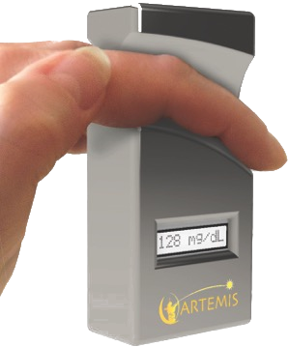
Solution
With a great deal of R&D in the rear view mirror, and the advancement of several key new technologies and components, we believe that we are onto the holy grail solution for blood glucometry: a small hand-held configuration that reads blood glucose through the skin without impact, finger prick, or instrumental transgression otherwise
We believe that we will be able to miniaturize our solution to not only be hand-held in geometry, but also to integrate with other common technologies, such as smartphones and smart-watches
The solution should be manufacturable in reasonably low volume to still meet operating margin targets – and also be priced below conventional finger-prick style glucometry, which will be incredibly disruptive to that embedded market
The solution will eliminate disposables such as test strips, finger-prick devices / lancets, guillotine lancets
Very importantly: without the pain, anxiety, and annoyance of the conventional glucometry, 50% of the population will understand their glucose levels in a much deeper manner; pre-diabetic and diabetic patients also will learn significantly more about what behaviors and food intake will impact their glucose levels, how, and with what kind of timing – very clinically relevant
Everyone knows someone who needs this
Diabetes generally is well-reimbursed in the US and other healthcare systems; economics should be very easy for the insurers
Artists Rendition: Artemis Device

Slide 7
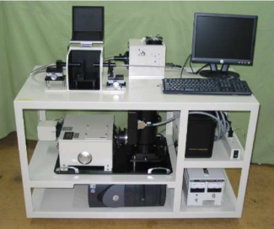
The Plan, Progress
R&D Prototype Size Device
Artists Rendition: Artemis Device
Founding, incorporation (Del C corp), clean cap table [Complete]
Prototype system design [Complete]
System/method/configuration IP [In Progress]
Live blood data from prototype system (full IRB) [Month 10]
Handheld miniaturized functional system [Month 22]
Manufacturing-ready prototype / final design [Month 31]
CE-mark for sales in Europe [Month 36]
FDA approval for sales in US [Month 60]

Slide 8
Capitalization
Straight forward Delaware C-corp
Incorporated Oct 2021
Cap table is clean
We are in the process of initial meetings to gather starter capital
Plan is to stay very efficient, have significant progress at the time of A round, get the technology to market
With initial validation/confirmation of the technology, IP complete, and early team in place, we believe that we will be positioned to have interesting discussions with strategics given the size of the market

Slide 9
Thank you

Slide 10
Market Opportunity
3rd Leading cause of death
1 in 16 People in the world have been diagnosed
1 in 10 People in the US have been diagnosed
1 in 3 People in the US currently have diabetes or are pre-diabetic
  1 in 2 By 2025
Nearly $2 Trillion are spent every year addressing diabetes
  1 out of every 4 Healthcare dollars address diabetes

Slide 11
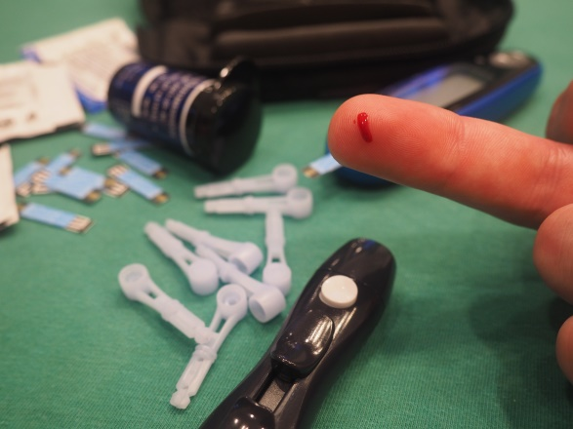
The Diabetic’s Dilemma
22% of people with diabetes must test blood glucose 4 or more times per day to avoid severe medical issues
The only test method reliable and accurate enough for all diabetic use cases is the finger prick glucometer
Finger prick glucometers are painful, inconvenient and require expensive supplies for each use

Slide 12
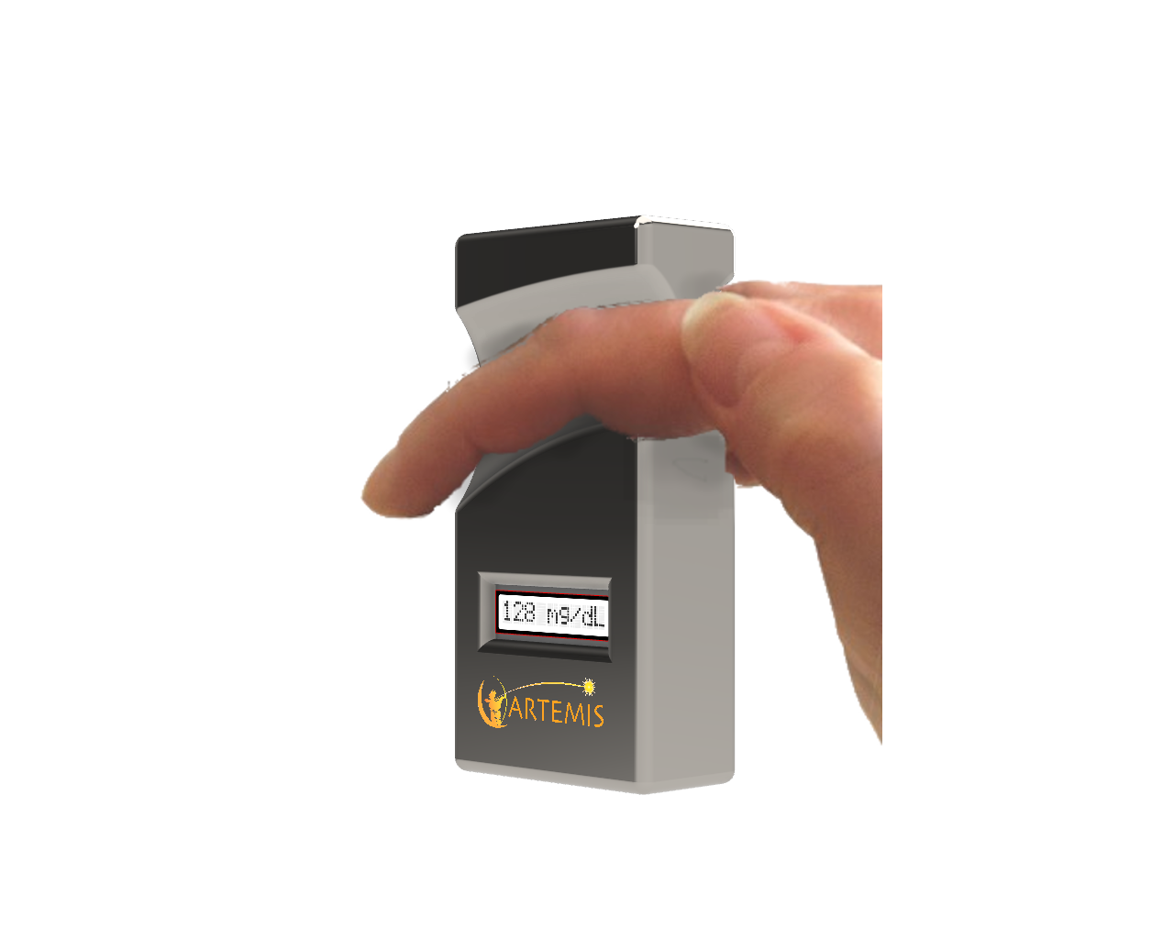
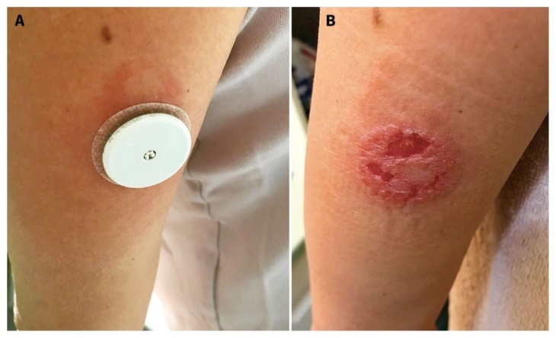
The Diabetic’s Dilemma
Other available glucometers
  Frequently cause pain and irritation
  Measure glucose in skin, not glucose in blood
  Are not approved for use in all cases
  Do Not Replace the Finger Prick Glucometer
What is needed is a pain-free, easy to use, blood glucometer
  An Artemis Device; the ONLY finger prick glucometer replacement

Slide 13
Diabetes Complications
Over long periods of time, regular episodes of high blood glucose concentration known as hyperglycemia lead to diabetic complications that result in:
  Cardiovascular disease
  Kidney disease
  Nerve disease
  Blindness and amputations
  Making diabetes and its complications is one of the leading causes of death

Slide 14
Our Solution
Our mission is to enable better management of diabetes with accurate noninvasive measurement of blood glucose concentration.
No fingersticks
No blood
No test strips
No pain
No limits on testing
Exclusivity provided by significant IP protection

Slide 15
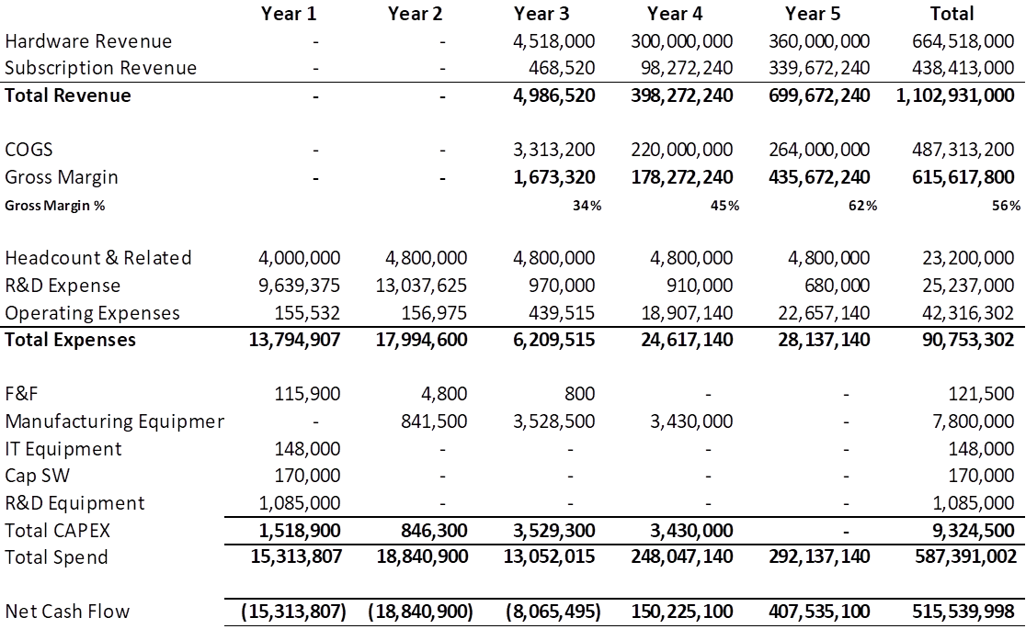
Financial Model

Slide 16
Business COGS/Pricing Modeling
Artemis NonInvasive SMBGM
Purchase price: $1200
Monthly maintenance fee: $68
Useful life is 36 months
Return to Artemis is $3648
NOTE: Cost to manufacture $955
Fingerstick SMBGM
Purchase price: $100
Monthly disposables: $99
Useful life is 36 months
CMS reimbursement is $3664
NOTE: CMS is Centers for Medicare & Medicaid Services

Slide 17
Competing Alternatives
Finger-stick Meters | Continuous Glucose Meters | Noninvasive
Roche Diagnostics | Dexcom | None
Johnson & Johnson | Medtronic
Abbott Diabetes Care
Bayer Healthcare
Boehringer Mannheim

Slide 18
IP Plan
We own a key portion of the core technology by virtue of two issued US patents
  Assigned to our corporation
  Invented and authored by Artemis founding team
We also have filed to protect the new design configuration and many variations thereof
  Primary indication in pursuit is blood glucometry
  We also have identified many other valuable addressable markets for compact, high-accuracy, portable, non-invasive spectroscopy
Experienced team on the strategy and execution

Slide 19
Development Gantt (next slide)
The US and EU design controls standards are harmonized. Therefore developing a Quality Management System that complies to all is easy and prudent. Also the safety/EMC standards are harmonized for the most part. So testing against one holds for both. Hence the 10 basic steps to get to FDA (and EU) are:
Generate Design Requirements and a Development Plan
Design and develop the system and hold Design Reviews
Build prototypes and test
Perform Risk Analysis
Conduct design Verification including Safety/EMC testing and Software validation
Generate Design Output
Develop Manufacturing Processes and Validate
Manufacture Units for Clinical Trial
Prepare and conduct Design Validation via clinical trial
Prepare FDA submission and Technical File for EU submissions
Steps 2 to 5 may have to re-iterate.
Artemis needs a Quality Assurance department along with Engineering to harmonize the quality controlled development process.

Slide 20
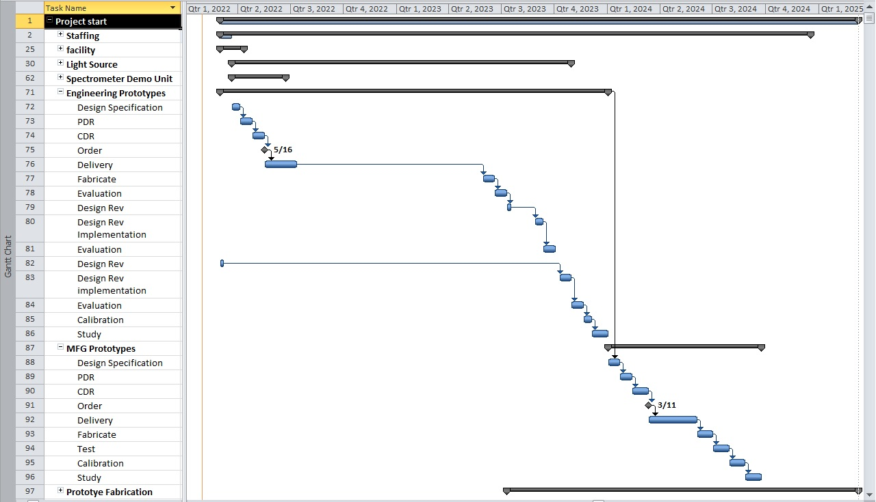
Gantt for Key Development

Slide 21
Regulatory US
There are four basic steps involved in getting FDA marketing clearance in US:
  Classify your device and understand applicable regulatory controls.
  Select and prepare the correct Premarket Submission.
  Send your Premarket Submission to the FDA and interact with the FDA staff during review.
  Comply with Applicable Regulatory Controls Including the Establishment Registration and Device Listing
Note that most likely the device will fall under Class II of FDA and will require a 510(k) Premarket Notification submission for marketing clearance.
In step 2, the Premarket Submission must show that the device was developed and tested as follows:
Design Controls: Class II and class III devices must be designed in accordance with Design Controls under the Quality System Regulation, 21 CFR 820.30.
Non-clinical Testing: This includes performance verification testing, which is usually conducted by the manufacturer, and compliance verification to Safety and Electro-Magnetic Compatibility standards such as UL 60601-1 and 47 CFR 15b, which is conducted by an accredited laboratory.
Clinical Evidence: Prior to initiating a clinical study, the study sponsor may need to obtain approval of an Investigational Device Exemption (IDE) by the FDA. The study will also need to be approved by the appropriate Institutional Review Board (IRB). Clinical studies must comply with all applicable IDE regulations and Good Clinical Practices (GCPs).
Labeling: The labeling for a device must be written according to labeling regulations, 21 CFR 801.

Slide 22
Regulatory EU
Classify Your Device and Understand Applicable Regulatory Controls.
Prepare a Technical File or Design Dossier for Class III with evidence of compliance to the Medical Devices Directive.
Send Technical File to a Notified Body, interact with Notified Body staff during review and Receive a CE Mark certificate from if Class I with Measuring or Sterile function, Class IIa, IIb, or III.
Appoint a European Authorized Representative if you have no physical location in Europe and register the medical device with the Competent Authorities, where applicable.
Again most likely the device will fall under Class IIa.
In step 2, the Technical File will require that the device was developed and tested as follows:
Design Controls: Medical devices must be designed in accordance with Design Controls under a Quality Management System certified to ISO13485.
Non-clinical Testing: This includes performance verification testing, which is usually conducted by the manufacturer, and compliance verification to Safety and Electro-Magnetic Compatibility standards such as IEC60601-1 and IEC 60601-1-2, which is conducted by an accredited laboratory.
Clinical Evidence: According to EN540 for clinical investigation.
Labeling: Labeling is part of Safety standard.

Slide 23
Regulatory Process FDA 510(k)
https://www.fda.gov/medical-devices/device-advice-comprehensive-regulatory-assistance/how-study-and-market-your-device
https://www.fda.gov/medical-devices/premarket-submissions-selecting-and-preparing-correct-submission/premarket-notification-510k
TRADITIONAL 510(k) submission
Most companies must submit a traditional 510(k) Premarket Notification which is a full 510(k) that includes all of the following sections:
Medical Device User Fee Cover Sheet
CDRH Premarket Review Submission Cover Sheet
510(k) Cover Letter
Indications for Use Statement
510(k) Summary or 510(k) Statement
Truthful and Accuracy Statement
Summary and Certification
Financial Certification or Disclosure Statement
Declarations of Conformity and Summary Reports
Executive Summary
Device Description
Substantial Equivalence Discussion
Proposed Labeling
Sterilization and Shelf Life
Biocompatibility
Software
Electromagnetic Compatibility and Electrical Safety
Performance Testing ? Bench
Performance Testing ? Animal
Performance Testing ? Clinical

Slide 24
Regulatory Process FDA PMA
Applicant submits “informal” PMA Shell to the attention of the CDRH Branch
Chief of the appropriate review division or to the applications division in the
appropriate CBER office.
Applicant submits final PMA Shell to DMC or DCC
Applicant submits PMA modules in accordance with
agreed upon schedule (each module subject to a 90-day
review clock)
Applicant submits final PMA module, thereby completing
the Modular PMA (180-day review clock)
Review division sends a letter to the applicant
accepting the shell
Applicant submits user
fee payment before 1st
PMA module
Applicant reaches
agreement with FDA

Slide 25
Regulatory Process Standards
EN1441 Medical devices – risk analysis
EN980 Graphical Symbols for Use in the Labeling of Medical Devices 80/181/EEC
BS EN1041 Information supplied by the manufacturer with medical devices
BS EN540 Clinical investigation of medical devices for humans
IEC601-1-4 Medical electrical equipment - Part 1: General requirements for safety - 4. Collateral standard: Programmable electrical medical systems
Any experimentation involving use of a medical device on a human subject falls under the IDE regulation and informed consent. If the medical device is a non-significant risk device, then FDA review of the IDE is not required - all you need is one hospital Institutional Review Board (IRB) to approve your clinical protocol and informed consent form, and you can conduct your study with oversight from the hospital IRB.

Slide 26
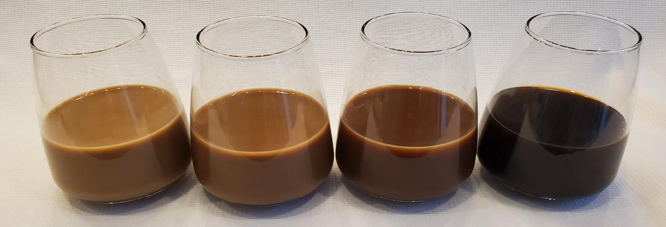
Artemis Technology
The Artemis Device is a Spectrometer
  A tool that uses the color of a substance to determine how much of the substance is in a mixture
  We use our eyes to do this every day
  For example, you can tell if there is a little or a lot of cream in the coffee in the image below, just by looking at the color

Slide 27
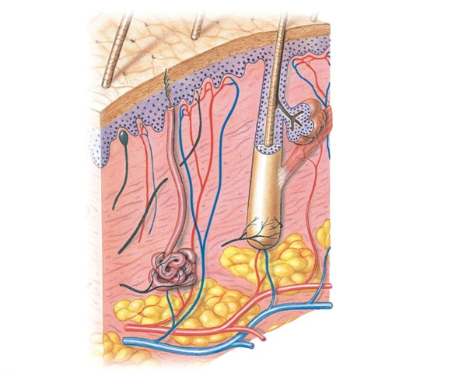
Capillary Blood and Clutter
To measure blood glucose, the Artemis Device needs to measure the color of the blood
  Specifically, the Capillary Blood
The skin is cluttered with features other than capillary blood
  Skin cells and fluid, hair, fat, nerves, sweat glands, etc.
This is what is measured
The Artemis Device will isolate this, the capillary

Slide 28
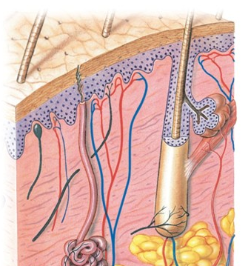
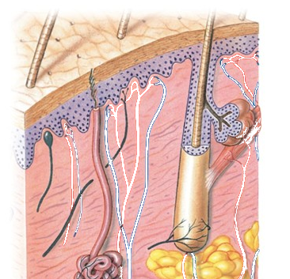
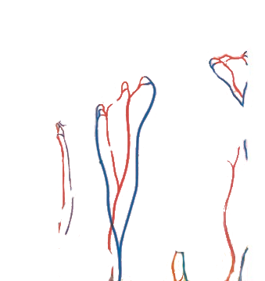
Artemis Unique “LightHunter” Technology Solution
A single skin measurement is very cluttered.
But blood changes color during the pulse
  It is more colored during high blood pressure
  And clearer during low blood pressure
The difference between low and high blood pressure measurements is capillary blood only
  This is called Pulse Differential Spectroscopy

Slide 29
Artemis Unique “LightHunter” Technology Solution
Artemis Pulse Differential Spectroscopy (PDS)
  The Artemis Patented approach is what allows the Artemis Device to sample blood glucose and ignore skin
  This technique sets Artemis apart from ALL other non-invasive and CGM technologies
  It allows the Artemis Device to be a true blood glucose meter

Slide 30
Will It Work?
We are confident. In 2007, Kanazawa University built an experimental, laboratory sized, Pulse Differential Spectroscopy (PDS) system which was shown to accurately resolve PDS measurements
  Glucose results were within the FDA statistical accuracy requirements
  The system was not commercially viable due to the required liquid nitrogen cooling for the ultra-low noise detector
  It was quite a different configuration because they were trying to address signal-to-noise ratio issues by thermodynamically reducing noise; but it DOES validate where we are headed with this PDS solution

